Slide 1

sales Analysis
Adventure works
Feb 14 2024
Business Analysis Team

Slide 2

KPI’s
Create a Bar chart to show yearwise Sales
Create a Line Chart to show Monthwise sales
Create a Pie chart to show Quarterwise sales
Create a combinational chart (bar and Line) to show Salesamount and Productioncost together

Slide 3
Year wise sales
Observations : -
sales Amount started trending up on 2013, rising by 17.66M in 4 years.﻿﻿﻿
Sales Amount jumped from .05 M to 17.66 M during its steepest incline between 2010 and 2013.﻿﻿
Suggestion : -
Year wise sale gradually increasing and need to maintain it and and this year have to see a raise about 50% from FY13.

Slide 4
Month wise sales
Observations : -
Season of sale mainly starting from may till the year end December
Highest sales are of 3.5M in December
Second highest is in the month of June at an average of 3.2M
Suggestion : -
Need to improve the first quarter of the year
Maintain the slope constant in one average months

Slide 5
Quarter wise sales
Observations : -
﻿Total quarter wise sales are as follows
Q1 19%
Q2 24%
Q3 26%
Q4 31 %
Q4 makes the highest sales in all over the FY﻿﻿
Suggestion : -
Need to improve in the Q1
Maintain constant grownts wit the other quarters of the year

Slide 6
Sales vs production cost
Observations : -
Suggestion : -
﻿﻿sales and production cost were high at FY13
﻿﻿In FY13 profit of 8.3 M profit genterated
﻿At .﻿﻿
Across all 12 Month, sales ranged from 18M to 23 M in FY14.﻿﻿
Q3,Q4 has the high potential than Q1,Q2 focusing more on and implementing new strategies in Q3,Q4 will result high conversion rate.
As mentioned earlier Q3-Q4 has more than 50% total contributions.
If we focus other with new strategies in Q3,Q4 we will turn up with good result.

Slide 7

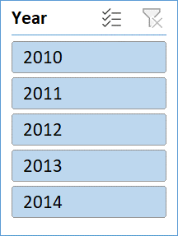

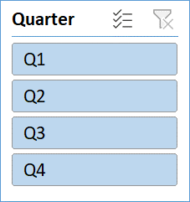
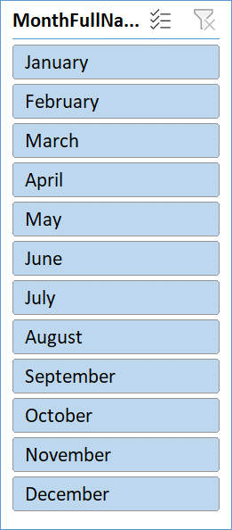

 | $Z$43 $Z$45 $AB$43 $Z$47 $AB$45
 |  |  |  |  |  |  |  |  |  |  |  |  |  |  |  |  |  |  |  |  |  |  |  |  | 14.43M |  | 17.28M
 |  |  |  |  |  |  |  |  |  |  |  |  |  |  |  |  |  |  |  |  |  |  |  |  | 31.71M |  | 2.35M
 |  |  |  |  |  |  |  |  |  |  |  |  |  |  |  |  |  |  |  |  |  |  |  |  | 60398
ADVENTURE WORKS
Profit
Sales
Production
No.of Orders
Tax

Slide 8
Team-2
Navateja
meenu
hiren
snehasish
sandesha
sandeep
pushkar

